Slide 1

Emprendemos
19/Julio/2023
Magister Eduard Duarte Sepúlveda

Slide 2

trabajo que tendrá más salidas
Motivación
Con la llegada del 2023 surgen dudas sobre el mundo laboral y cuál de todos va a ser el trabajo más rentable, mejor pagado y con mayores salidas. Sin embargo, parece que no hay duda y los desarrolladores de software se llevan un claro primer puesto.
¿Existe una necesidad real creciente de desarrolladores de software?
Los datos sugieren que para 2029, la demanda de ingenieros de software podría aumentar hasta el 22 %. Más de 4,7 millones de desarrolladores de software
https://computerhoy.com/tecnologia/trabajo-tendra-salidas-laborales-2023-1184100

Slide 3
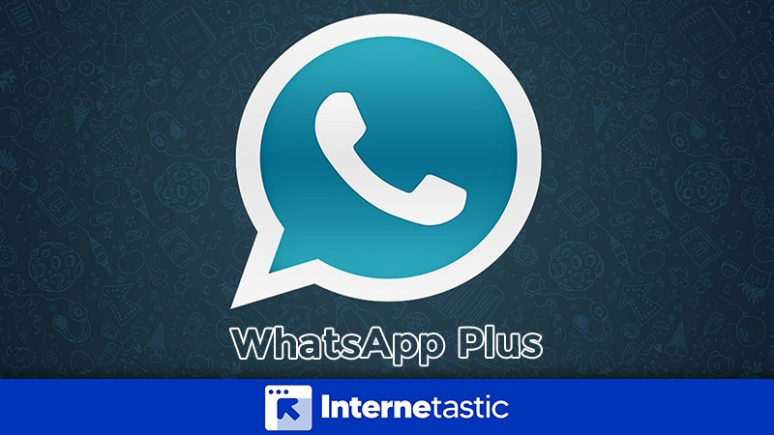
Extender funcionalidades de aplicaciones
Creando Valor

Slide 4
Conecting the Dots
Modelo de negocio
Modelo de negocio
Crear Valor de negocio
Entregar Valor de negocio
Capturar Valor de Negocio
(Ecuación Económica)
Propuesta de valor
Capacidades
Modelos de monetización
Story Telling
Use Cases
Metodológicas
Procesos
Ingresos
Costos
Observación
Requerimientos
Recursos
Digitales
Caso de ne gocio

Slide 5
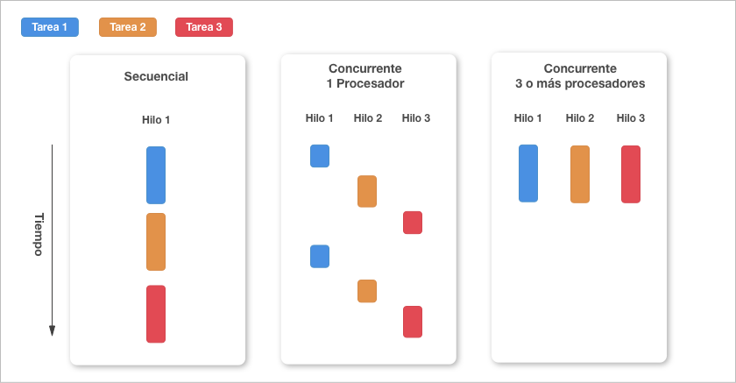
What is concurrency?
Creando valor
Why should I care about concurrency?

Slide 6
Comparing serverless concurrency on AWS Lambda, AWS App Runner, and AWS Fargate

Slide 7

The Evolution of Computing: Unveiling the Digital Revolution
Creating Value
Tandy 1000
Intel-8088 CPU at 4.77Mhz
128kb of memory
No hard drive at all!
Only ran one program at a time.
Each program came on its own disk.
Launching a new program required turning the computer off and back on again!

Slide 8
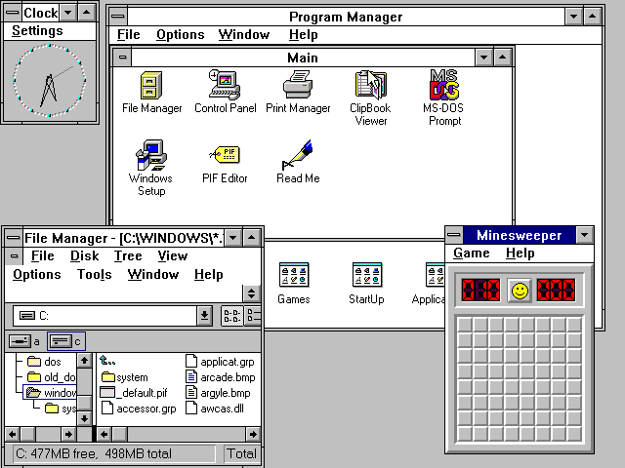
The Evolution of Computing: Unveiling the Digital Revolution
Creating Value
Windows 3.1
Cooperative multitasking
The foregrounded program is responsible for checking periodically to see if another program is asking to use the CPU. If so the foregrounded program can opt in to yielding to the backgrounded program.

Slide 9
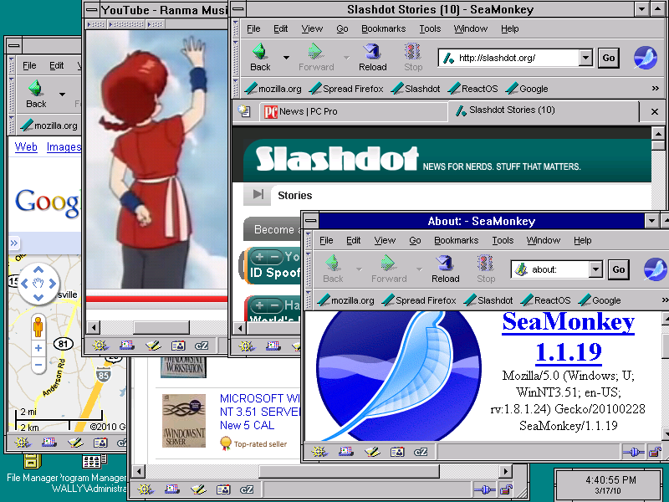
The Evolution of Computing: Unveiling the Digital Revolution
Creating Value
Windows 95 and Unix
Preemptive multitasking
The operating system has an interrupt system that can suspend a program, and a scheduler that determines which program should get a CPU time slice next.
Gives the illusion of parallel execution

Slide 10
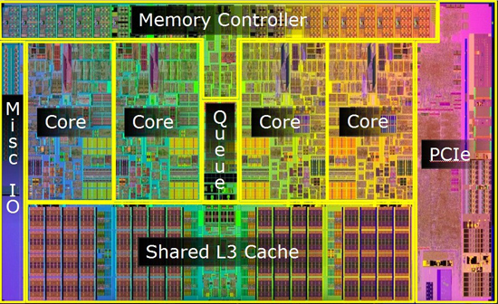
The Evolution of Computing: Unveiling the Digital Revolution
Creating Value
Multicore processors
Now the processor can actually run multiple programs at once. Operating systems still use multitasking, but now there can actually be multiple tasks running in parallel with each other.

Slide 11


The Evolution of Computing: Unveiling the Digital Revolution
Creating Value
Applications aren’t just local anymore
They have a client/server architecture
Application code and content
Telemetry, data persistence, social features

Slide 12
The Evolution of Computing: Unveiling the Digital Revolution
Creating Value
The server must handle concurrent requests from many clients at once

Slide 13
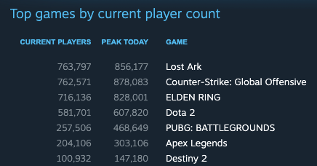
The Evolution of Computing: Unveiling the Digital Revolution
Creating Value
Concurrent players for several of the top online games on Steam.
All these games have a client/server architecture.
They have hundreds of thousands of concurrent users at all times!

Slide 14
The Evolution of Computing: Unveiling the Digital Revolution
Creating Value

Slide 15
The Evolution of Computing: Unveiling the Digital Revolution
Creating Value

Slide 16
The Evolution of Computing: Unveiling the Digital Revolution
Creating Value

Slide 17
The Evolution of Computing: Unveiling the Digital Revolution
Creating Value

Slide 18
The Evolution of Computing: Unveiling the Digital Revolution
Creating Value

Slide 19
The Evolution of Computing: Unveiling the Digital Revolution
Creating Value

Slide 21
Online applications compete with each other for attention. The middle ground keeps getting smaller.
Low Concurrency Applications
High Concurrency Applications
Your app will be either wildly successful or mostly ignored.

Slide 22
How do I build an application that can handle concurrency?
From zero users to millions

Slide 23



Serverless technologies help you start out small but then scale out when needed.
AWS Lambda
AWS App Runner
AWS Fargate

Slide 24
AWS Lambda
Your event handling function in the cloud

Slide 25
AWS Lambda runs your function in the cloud
Handler function
exports.handler = (event, context, callback) => {
callback(null, "Hello world!");
}

Slide 26

Different ways to execute the code: events
Invoke code via the AWS Lambda API
Handler function
AWS Lambda
exports.handler = (event, context, callback) => {
callback(null, "Hello world!");
}
Invoke code when a specific event happens: upload to an S3 bucket for example
Amazon EventBridge

Slide 27


Different ways to execute the code: web requests
HTTP Request
Application Load Balancer
Handler function
exports.handler = (event, context, callback) => {
callback(null, "Hello world!");
}
HTTP Request
Amazon API Gateway

Slide 28
“When a function is first invoked, the Lambda service creates an instance of the function and runs the handler method to process the event. After completion, the function remains available for a period of time to process subsequent events. If other events arrive while the function is busy, Lambda creates more instances of the function to handle these requests concurrently.”
- AWS Lambda documentation

Slide 29
Firecracker microVM
Handler function
cgroups – Used to constrain the function's access to CPU and memory.
namespaces – Each execution environment runs in a dedicated namespace. We do this by having unique group process IDs, user IDs, network interfaces, and other resources managed by the Linux kernel.
seccomp-bpf – To limit the system calls (syscalls) that can be used from within the execution environment.
iptables and routing tables – To prevent ingress network communications and to isolate network connections between MVMs.
chroot – Provide scoped access to the underlying filesystem.
exports.handler = (event, context, callback) => {
callback(null, "Hello world!");
}
Firecracker microVM
Handler function
exports.handler = (event, context, callback) => {
callback(null, "Hello world!");
}

Slide 30
AWS Lambda lifecycle
Cold Start
Init Code
Invoke Function Code
Downloading your code and loading it up for execution in its own isolated execution sandbox.
Any setup code outside your handler function.
Running your handler code, waiting for it to respond back with a result.

Slide 31
Each function only handles one invoke at a time
2 concurrent requests
3 concurrent requests
1 request
Cold Start
Function execution
Function Instance 1
Function Instance 2
Function
Instance 3
Cold Start
Cold Start

Slide 32
You pay for per millisecond for time spent in init code and invoking the handler function
Pay per ms
No charge
Cold Start
Init Code
Invoke Function Code

Slide 33
AWS Lambda is extremely cost effective when there are gaps between work to do
Pay per ms
Pay per ms
Cold Start
Init
Invoke
1 sec
Invoke
500 ms
Invoke
No charge
No charge
“Scale to zero”
No charge
“Scale to zero”

Slide 34
When there are multiple concurrent Lambda functions being invoked, each one charges concurrently.
Cold Start
Init
Invoke
Invoke
Invoke
Invoke
Cold Start
Init
Invoke
Invoke
Invoke
Invoke
Cold Start
Init
Invoke
Invoke
Invoke

Slide 35
What about when there are many concurrent Lambda functions?
Cold Start
Init
Invoke
Invoke
Invoke
Invoke
Cold Start
Init
Invoke
Invoke
Invoke
Invoke
Cold Start
Init
Invoke
Invoke
Invoke
Invoke
Cold Start
Init
Invoke
Invoke
Invoke
Invoke
Cold Start
Init
Invoke
Invoke
Invoke
Invoke
Cold Start
Init
Invoke
Invoke
Invoke
Invoke
Cold Start
Init
Invoke
Invoke
Invoke
Invoke
Cold Start
Init
Invoke
Invoke
Invoke
Invoke
Cold Start
Init
Invoke
Invoke
Invoke
Invoke
Cold Start
Init
Invoke
Invoke
Invoke
Invoke
Cold Start
Init
Invoke
Invoke
Invoke
Invoke
Cold Start
Init
Invoke
Invoke
Invoke
Invoke

Slide 36
Concurrency deep dive
What is actually happening during a request?

Slide 37
What is my application actually doing?
Handler Invoke (120ms)
Validate Input Payload (1ms)
Insert Row in Database, wait for response (10ms)
Handle DB response (1ms)
Call to downstream service and wait for response (100ms)
JSON serialize (8ms)
Many modern workloads are full of I/O operations

Slide 38
What is my application actually doing?
Handler Invoke (120ms)
Validate Input Payload (1ms)
Insert Row in Database, wait for response (10ms)
Handle DB response (1ms)
Call to downstream service and wait for response (100ms)
JSON serialize (8ms)
Running
Waiting
Running
Waiting
Running
I/O heavy workloads often spend more time waiting than running CPU instructions

Slide 39
The more concurrent activity I have, the more wasteful this looks. There are more ms of waiting than ms of executing CPU instructions
Cold Start
Init
Cold Start
Init
Cold Start
Init
Cold Start
Init
Cold Start
Init
Cold Start
Init
Cold Start
Init
What alternatives are there?

Slide 40

Most modern application frameworks make it possible to handle multiple concurrent requests in a single application process
Validate Input Payload (1ms)
Each second has 1000ms for a CPU core to do work.
Grab more work off the event loop whenever we are waiting on I/O
Event Loop
Handle DB response (1ms)
JSON serialization (8ms)

Slide 41
Instead of doing nothing while waiting, grab another event and do some work while we wait
Time
Validate Input Payload (1ms)
Waiting for DB
Handle DB response (1ms)
Waiting for downstream service
JSON serialization (8ms)
Request 1
Validate Input Payload (1ms)
Handle DB response (1ms)
Waiting for downstream service
JSON serialization (8ms)
Request 2
Waiting for DB
The event loop schedules work into all 1000ms of time per second.
A single application process can keep the CPU core busy by doing other work (like answering another HTTP request) while it waits on I/O

Slide 42
Node.js callbacks
Callback function that will be called 100ms later
exports.handler = function (event, context, callback) {
console.log('In the present’);
setTimeout(100, function() {
console.log('Time travel to 100ms later’);
callback();
});
}
Main function ends fast. Over the next 100ms until its time to run the callback function the process can pick up other work to do.
The handler could be invoked again, many times during the 100ms wait.

Slide 43
Node.js async/await
The await keyword yields back to the event loop to let the process start handling another request while it waits for the I/O to complete.
exports.handler = async function (event, context, callback) {
// Validate the event
let dbResponse = await db.insert(); // Wait for IO from DB
// Handle DB response
let downstreamResponse = await downstreamService.put();
// Serialize a JSON response
}
This is kind of like the cooperative multitasking approach of Windows 3.1

Slide 44
The amount of possible concurrency depends on the CPU time consumed
exports.handler = async function (event, context, callback) {
// Validate the event
let dbResponse = await db.insert(); // Wait for IO from DB
// Handle DB response
let downstreamService = await downstreamService.put();
// Serialize a JSON response
}
1ms
10ms
1ms
100ms
8ms
CPU time: 10ms
1000ms / 10ms = 100 function invokes/sec per single threaded app process

Slide 45
Upsides of concurrency: I/O deduping
Time
Request: fetch user ID 1
Query DB for user with ID 1
Waiting for DB
JSON serialize the DB response back to the client
<1 millisecond
10 milliseconds
<1 millisecond
Effective end to end time of this request is about 10 ms

Slide 46
Upsides of concurrency: I/O deduping
Time
Request: fetch user ID 1
Query DB for user with ID 1
Waiting for DB
JSON serialize, send response back to the client
10 milliseconds
There is already a query dispatched to the DB, just subscribe to its response
Request: fetch user ID 1
Query DB for user with ID 1
JSON serialize, send response back to the client
5 milliseconds
Reduced load on downstream service or DB. Decreased average latency.
Service becomes more performant with more concurrency.

Slide 47
Upsides of concurrency: I/O batching
Time
Request: PUT user metadata
UPDATE query to the DB
DB confirmation, return
200 OK status code
Typical POST or PUT API call flow: 1. Accept a JSON payload and validate it
2. Write it into a database
3. When the database operation succeeds, return a 200 OK status code

Slide 48
Upsides of concurrency: I/O batching
Time
Request: PUT user metadata
DB confirmation, return
200 OK status code
Add multiple user objects to one combined batch query
Request: PUT user metadata
DB confirmation, return
200 OK status code
Request: PUT user metadata
DB confirmation, return
200 OK status code
Request: PUT user metadata
UPDATE query to the DB
DB confirmation, return
200 OK status code
Latency rises a little, but DB load reduces

Slide 49
I/O batching gets better at higher concurrency
Dispatch a batch call when either condition is met:
- 10 milliseconds have passed
- 10 items have accumulated in the batch
Incoming Requests
Batches fill up and get dispatched faster at higher concurrency so latency lowers
Downstream API calls
Perceived latency

Slide 50



You can do batch calls with AWS services
(Not an exhaustive list)
Amazon DynamoDB
Amazon Simple Queue Service (Amazon SQS)
Amazon Simple Notification Service (Amazon SNS)
BatchWriteItem
SendMessageBatch
PublishBatch
BatchGetItem

Slide 51
Downsides of concurrency: What happens if you have too many requests per second?
Response Time
Code to run
Code to run
100%
CPU
Code to run
Code to run
Code to run
Event Loop
50%
Code to run
Memory
Code to run
Code to run
Code to run
0%
Code to run
Work starts queueing up
As CPU saturates the response time skyrockets

Slide 52
Solution: load balance across multiple copies of the application process
Processes could be both running on the same physical machine and sharing separate cores of a multicore machine.
Or they could be on their own machines.
Application Container
Event Loop
Load Balancer
Application Container
Event Loop

Slide 53
AWS App Runner
Each copy of your application handles many concurrent requests

Slide 54
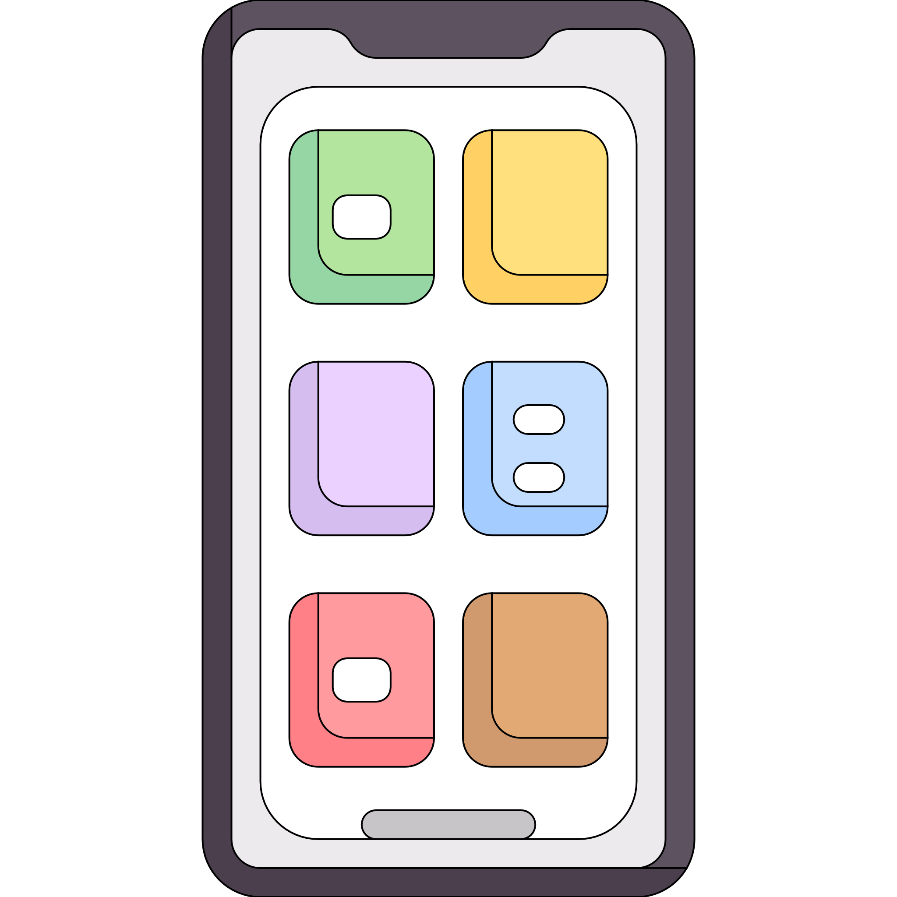
AWS App Runner manages horizontal scaling for you
AWS = Fully managed by AWS You = Your responsibility to manage
Scaling (AWS)
MicroVM (AWS)
Application Container
Event Loop
Ingress and Load Balancing (AWS)
Application code (You)
Client code (You)

Slide 55
You
Your client side code sends requests to the endpoint for an AWS App Runner service.
Envoy Proxy Load Balancer
The endpoint goes to a fully AWS managed Envoy Proxy load balancer
AWS
Each instance of your application container has its own concurrency limit and overflow queue.
Overflow Queue
Concurrent Requests Limit
You
Application Container
Your application receives concurrent requests, up to the limit you defined, and processes them
Event Loop

Slide 56
You
Envoy Proxy Load Balancer
AWS
429 Too Many Requests
Overflow Queue
Overflow Queue
Concurrent Requests Limit
Concurrent Requests Limit
You
Application Container
Application Container
Your application is protected from traffic bursts
Event Loop
Event Loop

Slide 57
In this example: Max container instances = 3
Traffic over time
429 errors
Cold Start
Traffic starts
Cold Start
App Runner scales out preemptively but make sure your app starts up fast or traffic might exceed available concurrency capacity
Extra traffic that can’t be served by three container instances starts to get 429 status code

Slide 58
= request arriving
Pay only for memory while there are no requests
Pay for CPU and memory when the application gets requests
Back to paying for CPU + memory
Cold Start
Active (Minimum one minute)
Provisioned (Not Active)
Active (Minimum one minute)
Request
Request
Request
Request
No requests
Request
Request
Request
Request
Request
Request

Slide 59
Traffic over time
1 x CPU + Memory
2 x CPU + Memory
2 x Memory
1 x Memory
Active
Provisioned (Not Active)
Cold Start
Active
Provisioned (Not Active)
Stop
Traffic starts
Traffic ends, both container instances go idle
App Runner stops one idle instance
Traffic rises past the concurrency limit of the first container instance, so another one is started

Slide 60
AWS Fargate
Serverless containers, but you manage scaling and concurrency

Slide 61
AWS Fargate provides microVM’s for your containers
AWS = Fully managed by AWS You = Your responsibility to manage
Scaling (You)
MicroVM (AWS)
Application Container
Event Loop
Ingress and Load Balancing (You)
Application code (You)
Client code (You)

Slide 62



You use an orchestrator to configure and manage your own customized deployment on AWS Fargate
Configuration
Ingress and Load Balancing
Developers
Orchestrator
“Run 10 copies of my app, register in this LB, scale up if CPU goes over 80%”
Deployments and scaling
AWS Fargate
Application metrics

Slide 63

AWS Fargate gives you more choices
Fully AWS managed API. Only pay for the Fargate tasks.
Amazon Elastic Container Service
API
AWS managed open source deployment. Pay for your personal deployment of the control plane
Amazon Elastic Kubernetes Service

Slide 64
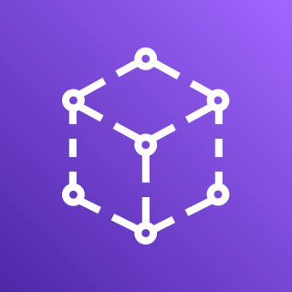
AWS Fargate gives you more choices
Application Load Balancer
Level 7, HTTP(S)
Network Load Balancer
Level 4
Ingress and Load Balancing
AWS App Mesh
Gateway
Amazon API Gateway

Slide 65


AWS Fargate gives you more choices
Step Scaling
Target Tracking
Scheduled scaling
AWS Auto Scaling
Scaling
Scale based on concurrency, CPU utilization, available messages in an SQS queue, or any other custom metric
Amazon CloudWatch

Slide 66
AWS Fargate charges based on time, not activity
Pay a constant rate per second for the task CPU and memory, whether there is traffic or not
Cold Start
Task Running
Stop
Request
Request
No requests
Request
Request
Request
Request

Slide 67





AWS Fargate price saving strategies
Fine tune CPU and memory size to match application needs. Fargate offers tiny task sizes for small applications
AWS Fargate is part of AWS Compute Savings Plans
Savings Plans
AWS Fargate has spot tasks for a discounted price as well as AWS Graviton2 powered tasks with Arm architecture
Spot Tasks
Graviton2

Slide 68
So which serverless option is right for my application?

Slide 69
AWS Lambda
AWS App Runner
AWS Fargate
Per ms, per invoke, based on memory size of function.
Each concurrent invoke is charged separately.
Per container instance per second, based on CPU and memory.
Container instances only charge for memory when not serving traffic.
Per container instance per second, based on CPU and memory.
Constant price whether or not traffic is being served.
Pricing

Slide 70
AWS Lambda
AWS App Runner
AWS Fargate
Each request is priced per millisecond, rounded up to the nearest millisecond.
When a container instance activates there is a minimum active time of one minute.
Active duration rounded up to the nearest second.
Pricing is calculated per second with a 1 minute minimum.
Task duration rounded up to the nearest second.
Pricing Resolution

Slide 71


AWS Lambda
AWS App Runner
AWS Fargate
Not included
Built-in
Not included
Web Traffic and Ingress
Manage your own API Gateway or Application Load Balancer
Just call the endpoint for your App Runner service, no need to manage anything.
Manage your own API Gateway or Application Load Balancer

Slide 72
AWS Lambda
AWS App Runner
AWS Fargate
Each function instance only serves a single invoke at a time.
Lambda increases the number of function instances as needed.
Each container instance serves concurrent requests up to your limit.
App Runner manages the number of container instances automatically
No built-in scaling.
You implement your own custom scaling policy using an orchestrator, your metrics, and AWS Auto Scaling
Scaling

Slide 73
AWS Lambda
AWS App Runner
AWS Fargate
Per Process
Isolation
Per Request
Isolation

Slide 74
A range of serverless compute for different needs
AWS Fargate
AWS App Runner
AWS Lambda
Configurable
Control
More complex
Opinionated
Fully Managed
Simple

Slide 75
Conclusion
Q&A Or chat with @nathankpeck on Twitter

Slide 76
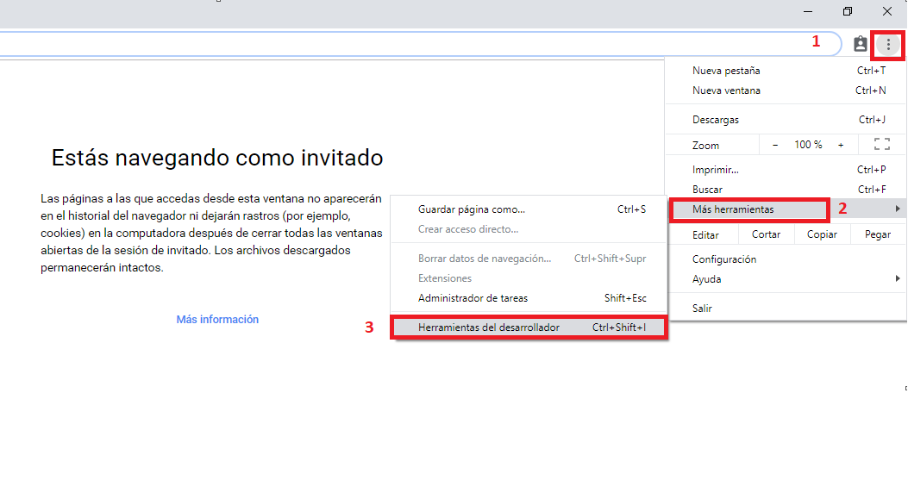
Modo desarrollador en Google chrome
Entregando valor
https://help.wnpower.com/hc/es/articles/360035684632-Acceder-a-Herramientas-para-desarrolladores-en-Google-Chrome

Slide 77
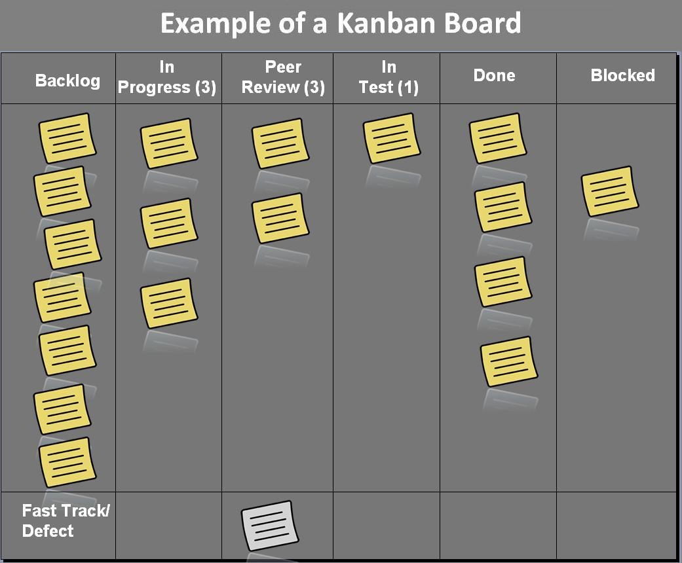
Tablero kanban
Entregando valor

Slide 78
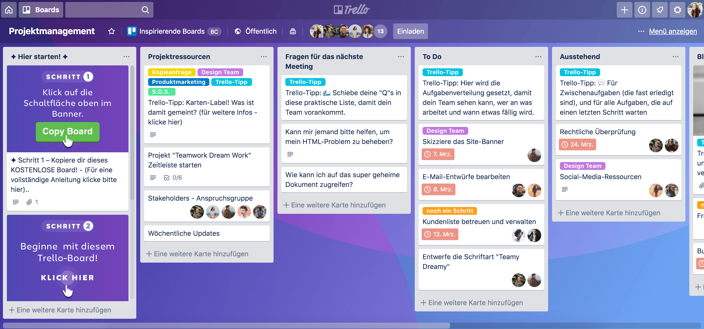
Tablero Trello
Entregando valor

Slide 79
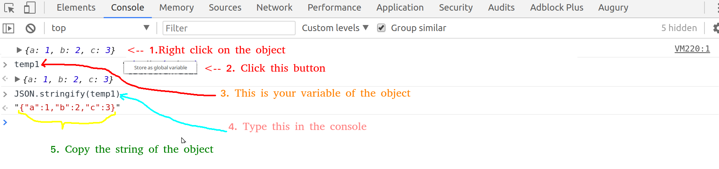
Consola de Google Chrome - javascript
Entregando valor

Slide 80
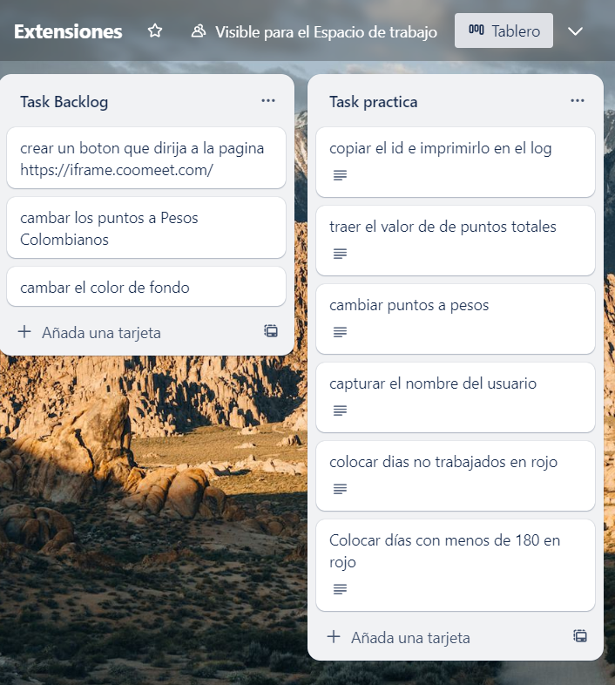
Hagamos la practica
Entregando valor
https://trello.com/b/AACxaIFJ/extensiones

Slide 81

Muchas Gracias
Notes:
Cultura y velocidad distinta….
Plantear argumentos

